Slide 1
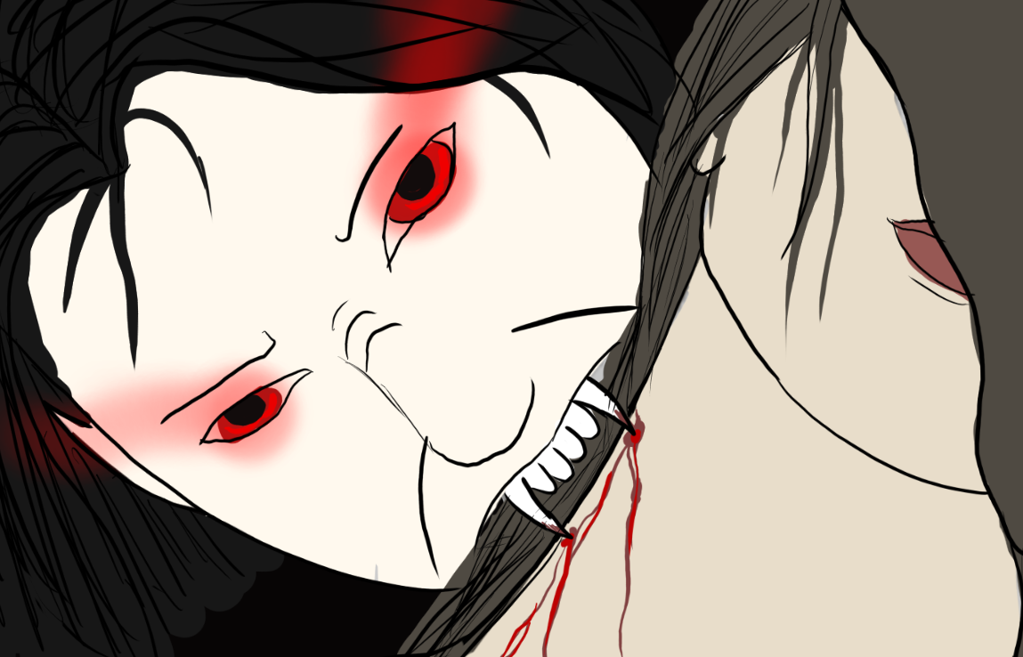

Midnight Blood
Stalk the streets
hunting unwitting villagers,
Before the rising sun
foils your reign of carnage!

Slide 2
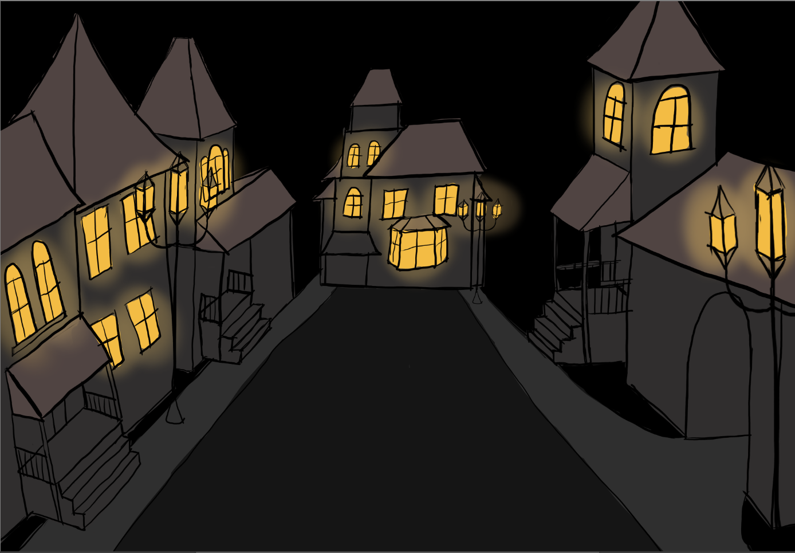
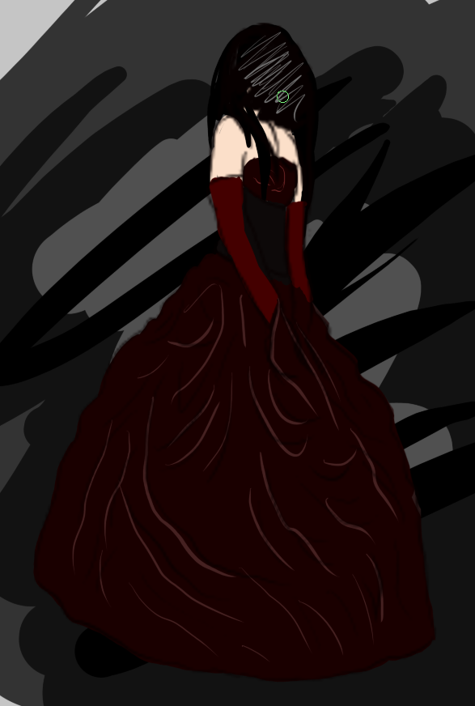
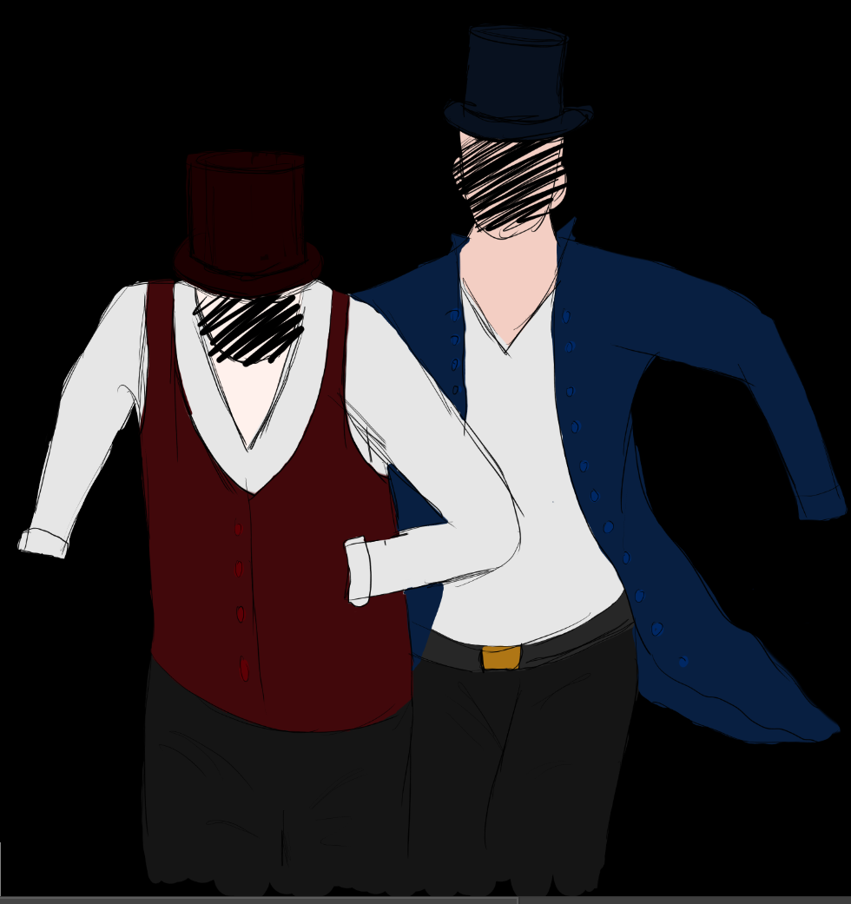
stalk the streets at night hunting your prey!
How many nights will you survive ?
Beware!
if someone sees you
the authorities will come running!

